Slide 1
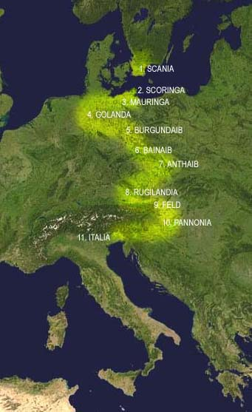
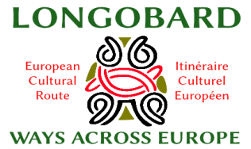
Longobard Ways across Europe

Slide 2
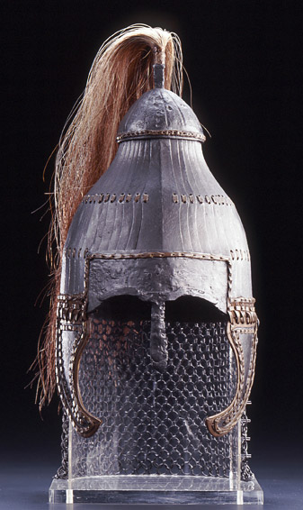
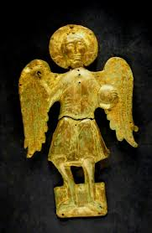
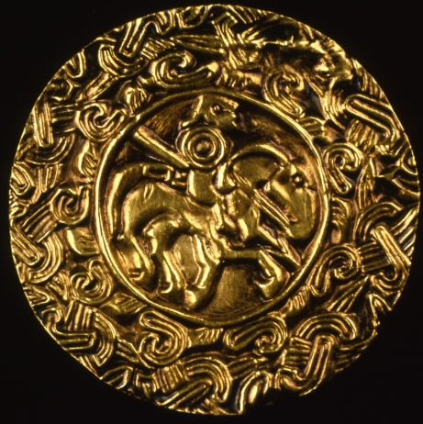
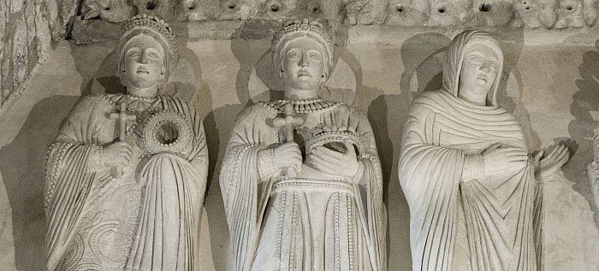
The Longobards
4 Historical periods across Europe
4 Macro-areas
Evolution
Melting-pot of Peoples, Cultures and Traditions
First steps of the European Culture

Slide 3
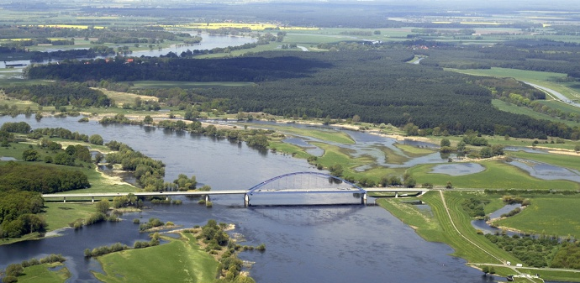
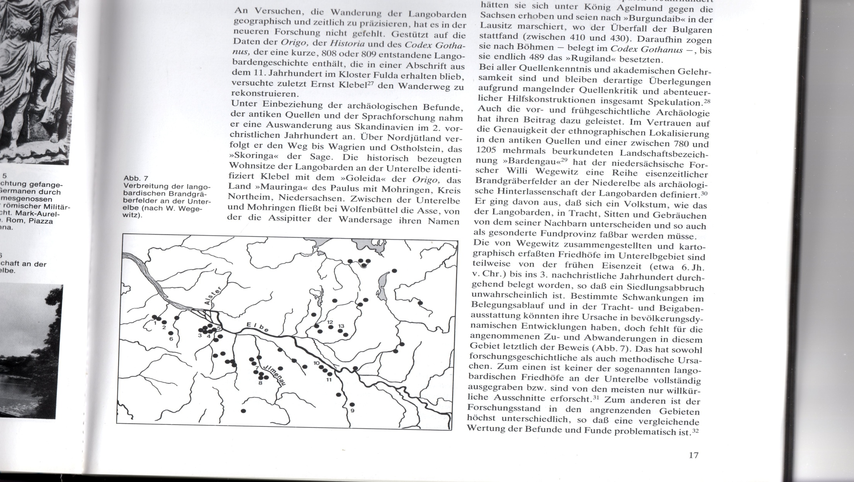
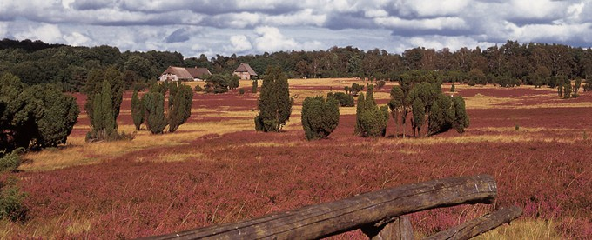
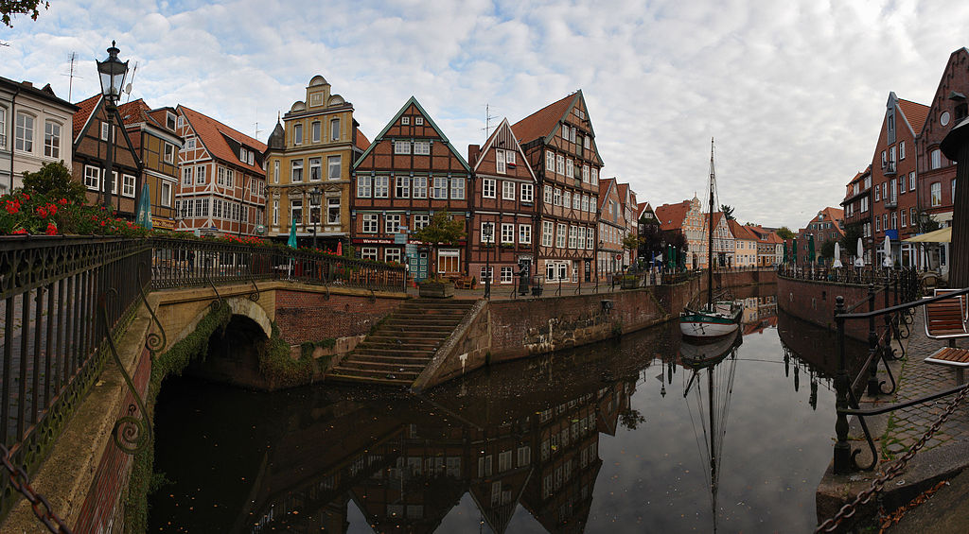
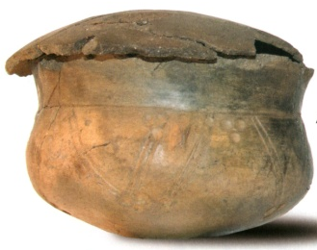
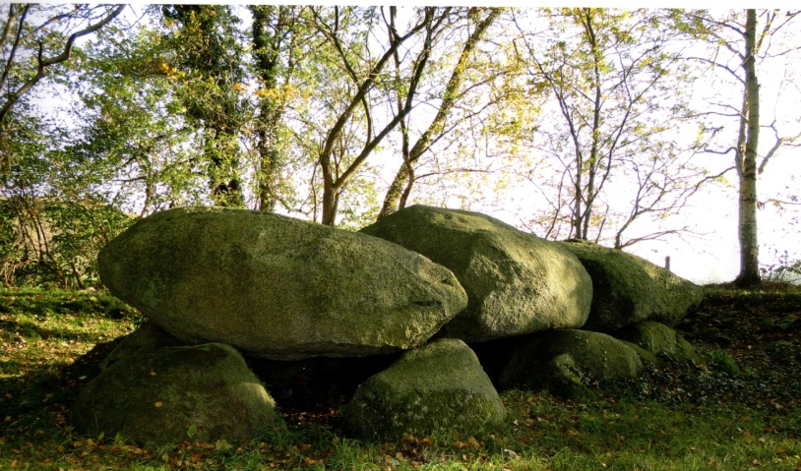
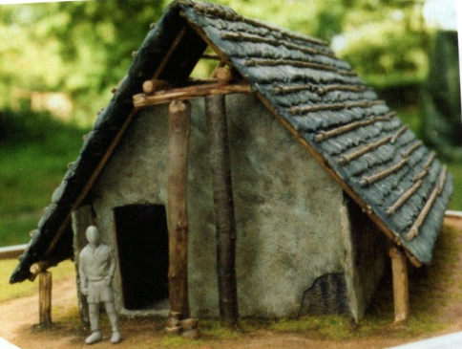
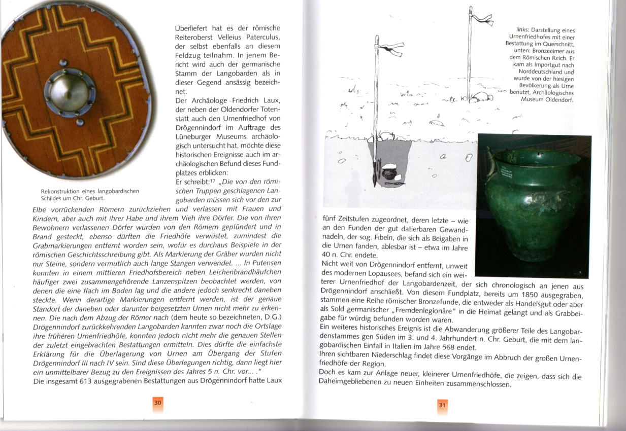
The ethnogenesis
Elbe
Lüneburg-Heide
Stade

Slide 4
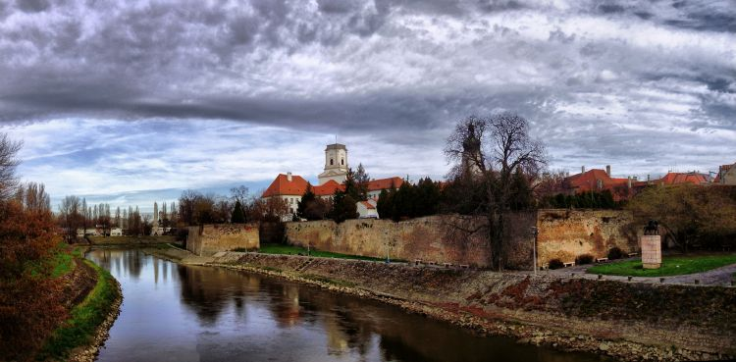
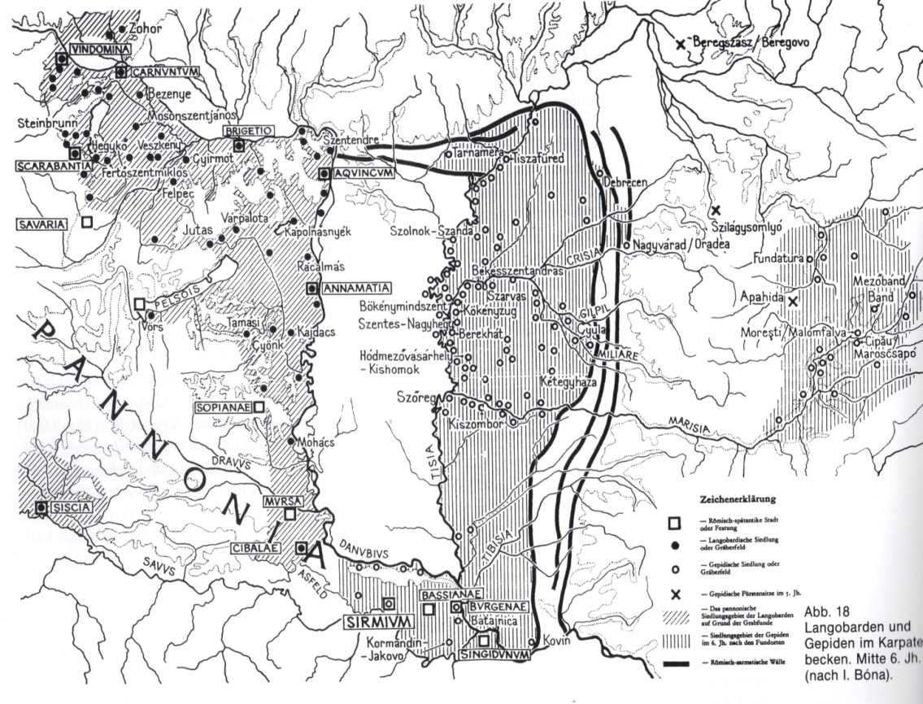
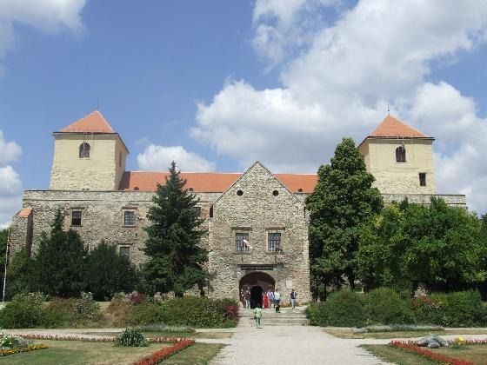
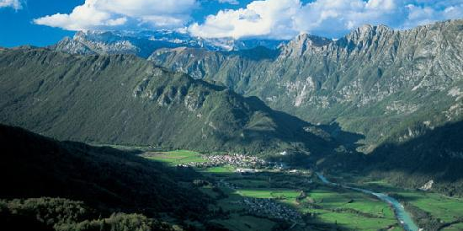
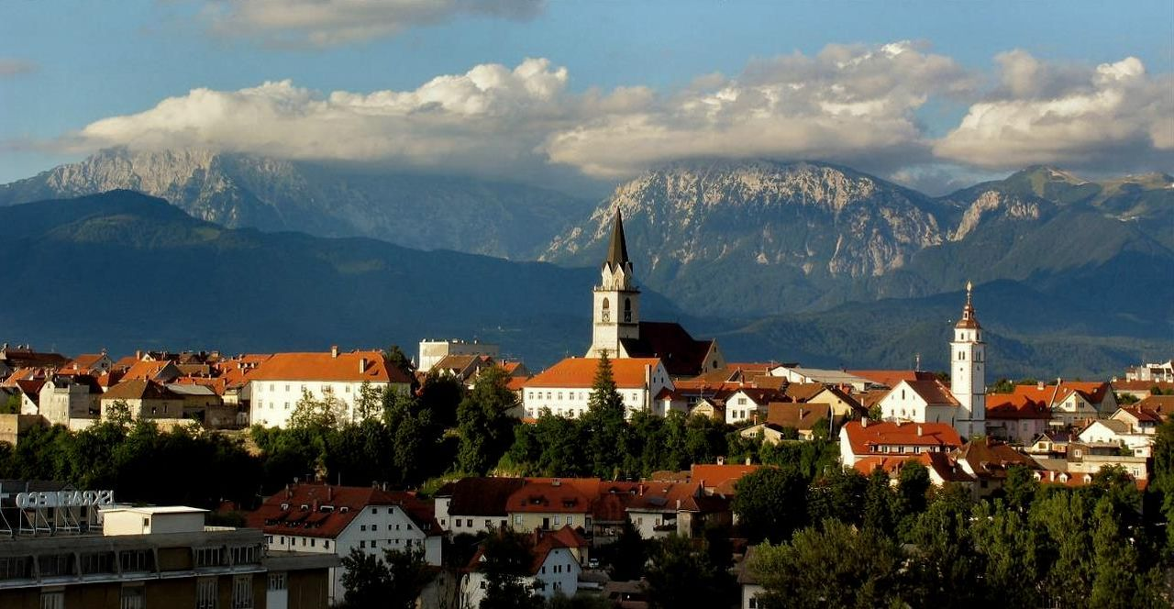
Kings’ power
Győr /Hungary
Varpalota/Hungary
Kobarid/Slovenia
Kranj/Slovenia

Slide 5
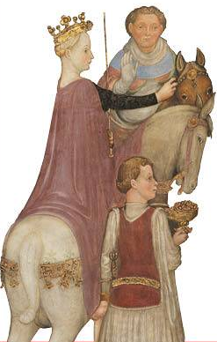
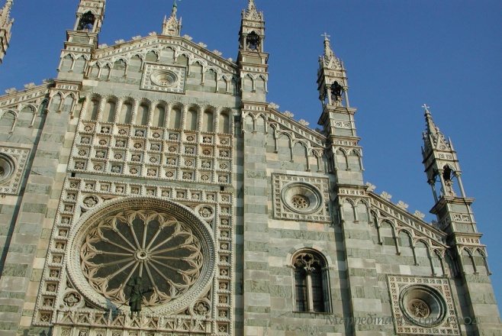
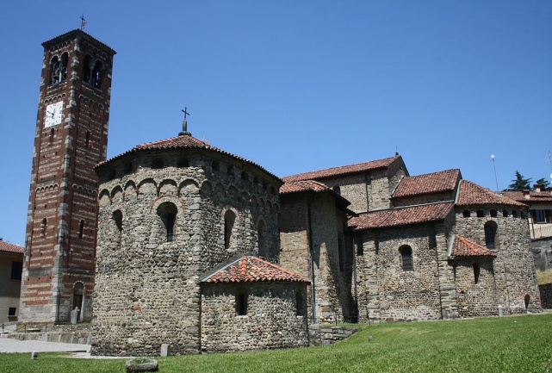
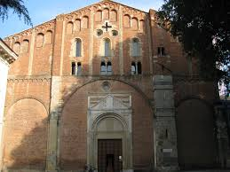
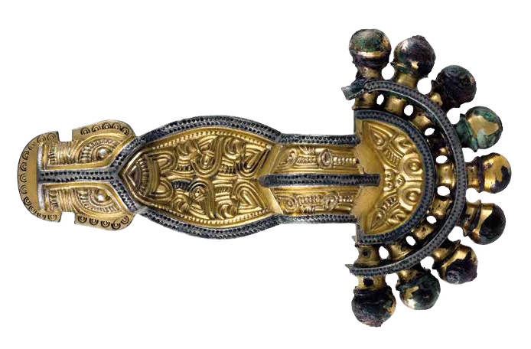
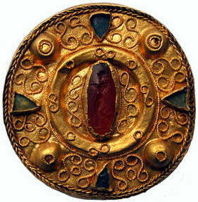
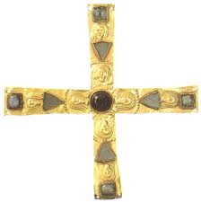
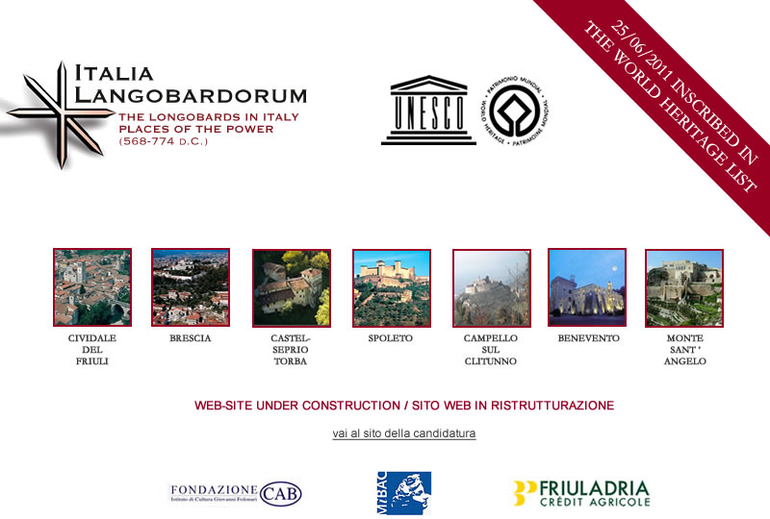
Longobard Kingdom of Italy
Monza / S. Giovanni Battista
Agliate / S. Pietro e Paolo
Pavia / S. Pietro in Ciel d’Oro

Slide 6
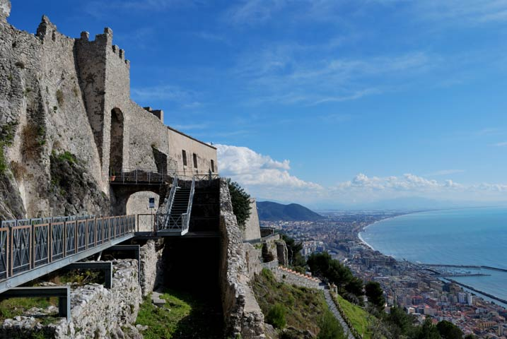
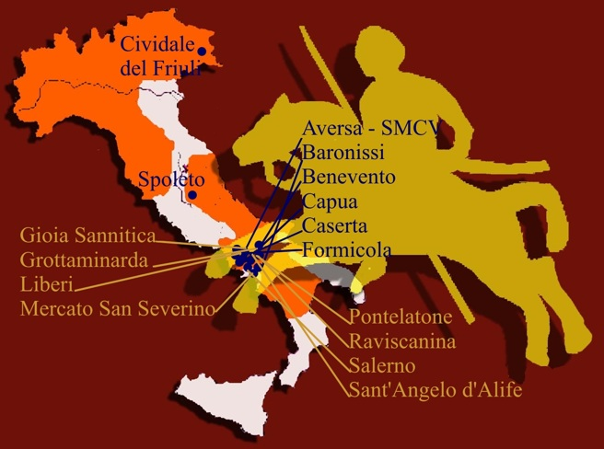
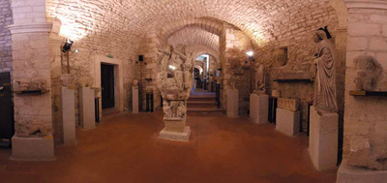
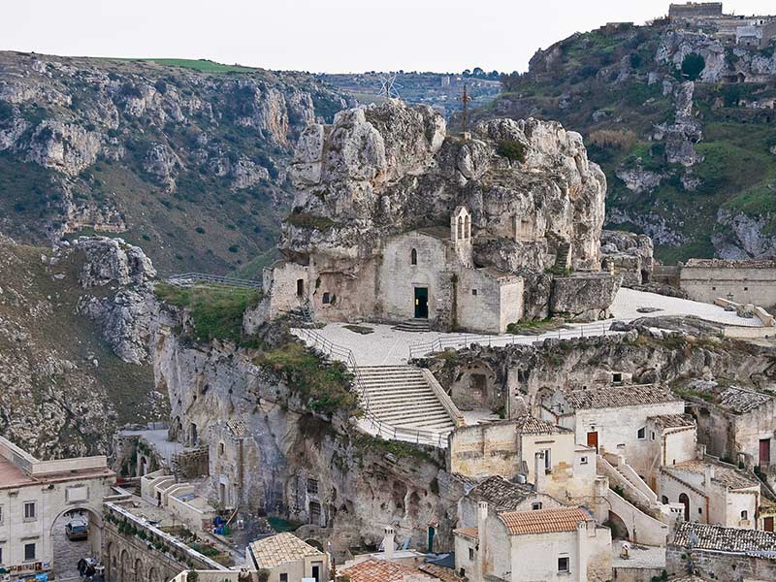
Southern Kingdom
SALERNO /
Palazzo di Arechi II
Monte sant’angelo/
Galleria longobarda
matera/
Chiese rupestri

Slide 7
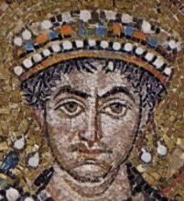
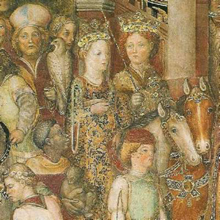
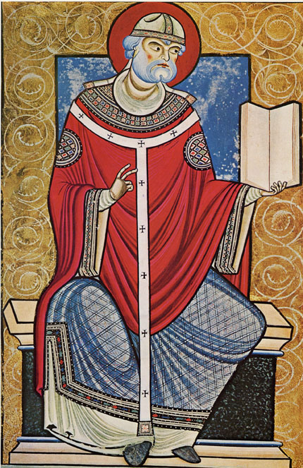
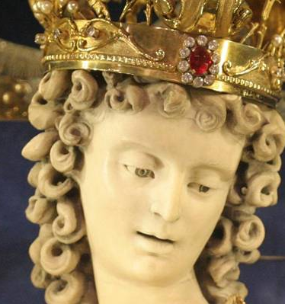
Longobard evolution
MITH / ETHNOGENESIS from Freya to Wotan
Scandinavia-Niedersachsen Agricolture Nomadism
Mecklenburg-Vorpommern Sedentary lifestyle Worriors
Urnfield culture
Kings’ power Contacts with Byzantine Empire ➔Greek-gothic war
Central-East Europe Burials
Contact wih Arianism
Marriage alliances (Wacho ➔ Waldrade-Garipold)
KINGDOM OF ITALY from Theudelind to Gregorio Magno
568-774 Bavarian dynasty
Legislation
Royal inheritance
SOUTHERN KINGDOM from Wotan to St.Michael
568-1076 Dissemination of cults
Contact with Arab culture

Slide 8
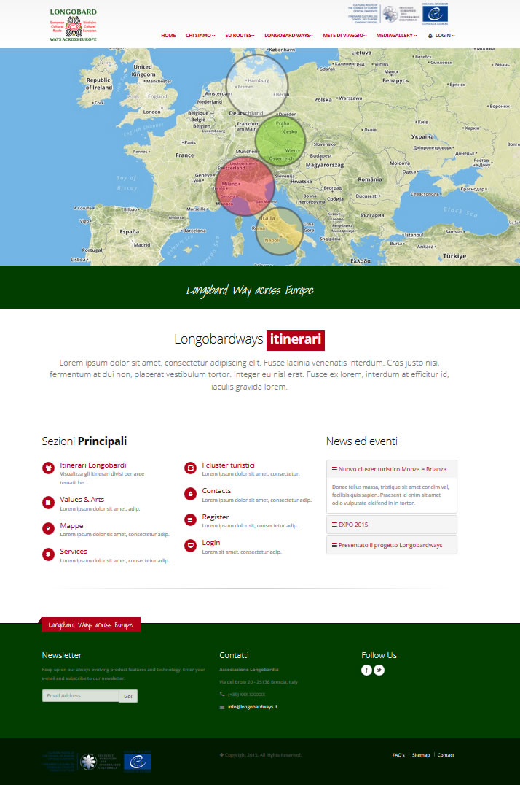
The file rouge

Slide 9
Organization of Territories
MACRO-AREA
Cluster 1
Cluster 2
Cluster 4
Cluster 5
Cluster 3

Slide 10
System and governance
Macro-areas
Clusters
Identity
Brand
Development
Monitoring
Coordination system

Slide 11
Functions and activities

